Slide 1

Modular Programming(1-dars)
Davronbek Malikov

Slide 2


Bugun
Yangi oyda nimalar o’rganamiz?
Group bo’lib rivojlanish
Githubda jamoaviy ishlash
Modular Programming(basics)
Git nima?
Git vs Github

Slide 3
Yangi oyda nimalar o’rganamiz?

Slide 4

Yangi bo’limda nimalar o’rganamiz?
Modular Programming
Git va Githubda ishlash
Deployment
Supervised ML (qo’shimcha mavzular)
Xar xafta 1 tadan toliq Project(4 ta jami)
Vazifalarga: 10 balldan(2-dars boshlanishidan 2 soat qolgunicha)

Slide 5
Group bo’lib rivojlanish

Slide 6

Group bo’lib rivojlanish
2 ga bo’linamiz
Team Leaderlar
Asosiy sharti: Xaftada kamida 2 ta zoom dars + davomat(to’liq qatnashgan bolishi kerak o’quvchi)
G’olib groupni xar bir a’zosiga chegirma
G’oliblar qanday aniqlanadi?
Mean(Sum of Final scores)

Slide 7
Githubda jamoaviy ishlash

Slide 8





Githubda jamoaviy ishlash
Repository(team leaderlar ochadi)->Settings->Collaborators->Add People->Set Permissions
Set Permissions:
Read(New members)
Write(push, create)---Team members
Admin(full access)---- Manager
Qayerda(dropdown menu, after confirmation)

Slide 9

Githubda jamoaviy ishlash
Nima uchun foyda:
Yangi ishga kirganda oson kirishib ketish
Tartibli ishlash
Git yordamida xoxlagan vaqtda Rewind (history)
Oson boshqaruv
Xar bir o’quvchu kunlik report topshiradi

Slide 10
Modular Programming(basics)

Slide 11

Modular Programming(basics)
What:
What modular Programming?
Module=Units
Mudullar-- class va funksiyalarni o’z ichiga olgan filelar
Package---- Modullarni o’z ichiga olgan ‘katta’ papka

Slide 12

Modular Programming(basics)
Why:
Modular Programmingsiz:
Barcha filellar birgalikda tushunarsiz
Xatolarni topish, test qilish va qaytadan ishlatish qiyin
Bitta ipynb fileni Ichida : DP, DA, FE, Model training, testing?
Modular Programming bilan:
Tartibli, oson qayta ishlatadigan va oson test qilanadigan unitlardan(modullardan) tashkil topgan project

Slide 13
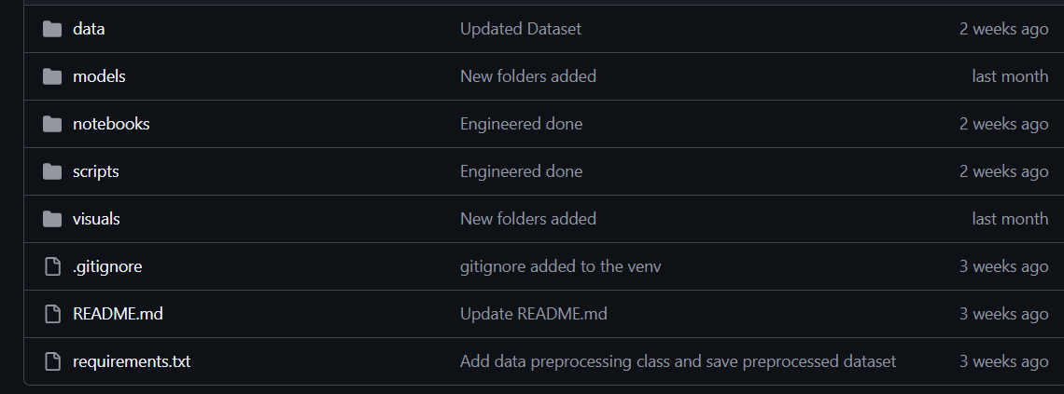

Modular Programming(basics)
How: (Project 1)

Slide 14
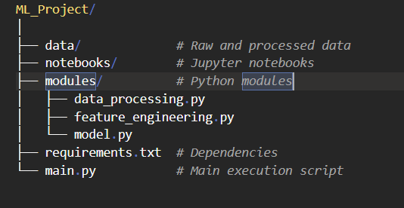

Modular Programming(basics)
How: (Project 1)
Mantiqiy tartiblash

Slide 15


Modular Programming(basics)
Nimalarni bilishimiz kerak(1)
Coding Structure(functions, classes, folders, modules,packages)
Project Organization
Data
Notebooks
Modules
Main.py
Requirements.txt
README.md
Virtual environment

Slide 16

Modular Programming(basics)
Nimalarni bilishimiz kerak(2)
Version control
Version Control(git)

Slide 17

Modular Programming(basics)
Nimalarni bilishimiz kerak(3)
Coding best practices:
Commands
Consistent naming
Error handling
Logging for info in the changings

Slide 18

Modular Programming(basics)
Nimalarni bilishimiz kerak(4)
ML-Specific Considerations(Data Extraction…Pipeline)

Slide 19

Git nima?

Slide 20


Git nima?
Version Control system
Ko’plab o’xshash papka-> Git
Nima uchun foydali:
Barcha o’zgarishlar saqlanib qoladi
Xoxlagan paytda tiklab olsa bo’ladi
Tartibli ishlay olamiz
Group Collabaration
Barchasi commandlar bilan

Slide 21
Git vs Github

Slide 22

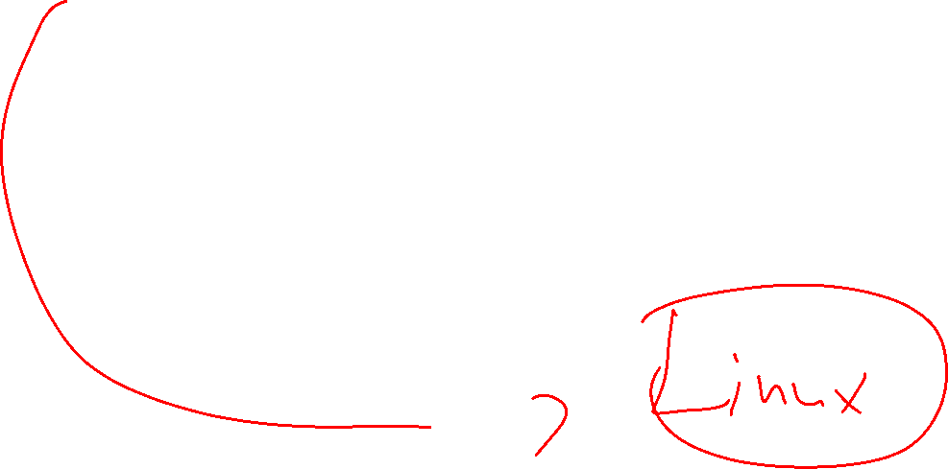
Git vs Github
Gitning ustiga qurilgan user – friendly application bu github
Gitsiz Projectlarda Githubda foydalana olmaymiz
Internet orqali ishlaydi
Git bu Githubning yuragi

Slide 23
Project

Slide 24

Project
Modular Programminga mos Project qiling
Qanday: Qiziqarli+ Foydali
Deadline: 3 - dars boshlanishidan 1 soat oldin va 3-darsda ximoya

Slide 25
Vazifa

Slide 26
Vazifa
O’rganilgan xar bir tushunchani list qiling va min bir qator tarif bn to’ldiring( Kunlik report shaklida repository ga yuklang(Alohida Folder oching)
Alohida Repository (profil) oching
Project 1 ni boshleng(Data Preprocessingacha)
Savol javob va DP ga tayyor boling
Classga oid misollar ishlang:
BankAccountni nomli class yarating va u class yordamida xozirgi, pul qoshgandan keying, va pul yechib olgandan keying xolatni ko’rsatsin
StudentGrades class yarating va unda talabalarning ismi, baxolar royxati bolsin va shunga kora ularning Ichida eng past, eng yuqori olgan talaba va o’rtacha ballni qaytarsin
O’zingiz xaqingizda malumot beruvchi class yarating(oldingi oydan farqli)

